Slide 1

GAMING ZONE USING PYTHON
BIRBHUM INSTITUTE OF ENGINEERING & TECHNOLOGY
COMPUTER SCIENCE & ENGINEERING
OBJECTIVE
1
ABSTRACT
2
INTRODUCTION
3
GAMING ZONE MENU
4
PROJECT PROPOSAL
5
SOFTWARE & MODULE
6
FINAL OVERVIEW
UNDER THE GUIDANCE OF
MR. KAZI MD. ARFIN (ASSISTANT PROFESSOR)
SUBMITTED BY:
BITTU DEY (CSE-03/18)
SUJIT MAITY (CSE-05/18)
DEBARATHI SARDAR (CSE-20/18)
Notes:
Under the guidance of Mr. Kazi Md. Arfin (Assistant Professor)

Slide 2
ABSTRACT:
A graphics-based operating system interface that uses icons, menus and a mouse to manage interaction with the system. Developed by Xerox, the GUI was popularized by the Apple Macintosh in the 1980s. At the time, Microsoft’s operating system, MS-DOS, required the user to type specific commands, but the company’s GUI, Microsoft Windows, is now the dominant user interface for personal computers (PCs). A comprehensive GUI environment includes four components: a graphics library, a user interface toolkit, a user interface style guide and consistent applications. The graphics library provides a high-level graphics programming interface. The user interface toolkit, built on top of the graphics library, provides application programs with mechanisms for creating and managing the dialogue elements of the windows, icons, menus, pointers and scroll bars (WIMPS) interface. The user interface style guide specifies how applications should employ the dialogue elements to present a consistent, easy-to-use environment to the user. Application program conformance with a single user interface style is the primary determinant of ease of learning and use, and thus, of application effectiveness and user productivity.

Slide 3
Designing the visual composition and temporal behavior of a GUI is an important part of software application programming in the area of human–computer interaction. Its goal is to enhance the efficiency and ease of use for the underlying logical design of a stored program, a design discipline named usability. The visible graphical interface features of an application are sometimes referred to as chrome or GUI (pronounced gooey).
Typically, users interact with information by manipulating visual widgets that allow for interactions appropriate to the kind of data they hold. The widgets of a well-designed interface are selected to support the actions necessary to achieve the goals of users. A model–view–controller allows flexible structures in which the interface is independent of and indirectly linked to application functions, so the GUI can be customized easily. This allows users to select or design a different skin at will, and eases the designer's work to change the interface as user needs evolve. Good user interface design relates to users more and to system architecture less. Large widgets, such as windows, usually provide a frame or container for the main presentation content such as a web page, email message, or drawing. Smaller ones usually act as a user-input tool.

Slide 4
INTRODUCTION:
Tkinter is Python's de-facto standard GUI (Graphical User Interface) package. It is a thin object-oriented layer on top of Tcl/Tk. Tkinter is not the only GuiProgramming toolkit for Python.
Tkinter is the Python interface to Tk, which is the GUI toolkit for Tcl/Tk. Tcl (pronounced as tickle) is a scripting language often used in testing, prototyping, and GUI development. Tk is an open-source, cross-platform widget toolkit used by many different programming languages to build GUI programs.
It is however the most commonly used one. Tkinter is the inbuilt python module that is used to create GUI applications. It is one of the most commonly used modules for creating GUI applications in Python as it is simple and easy to work with. You don’t need to worry about the installation of the Tkinter module separately as it comes with Python already. It gives an object-oriented interface to the Tk GUI toolkit.
Some other Python Libraries available for creating our own GUI applications are
Kivy
Python Qt
wxPython
Among all Tkinter is most widely used in this Project.

Slide 5
PYTHON GUI GAMING ZONE MENU:
Gaming Zone is a closed space that fills you with excitement and joy as soon as you enter it. Hence, it is essential to make the interior of the room a bit edgy to keep the vibe intact. Right home décor ideas can elevate the idea of a game zone into a practical space that invites attention.
A menu is a set of options presented to the user of a computer application to help the user find information or execute a program function. Menus are common in graphical user interfaces (GUI s) such as Windows or the Mac OS. Menus are also employed in some speech recognition programs.

Slide 6
1. SNAKE GAME
The concept of Snake originated from the 1976 arcade game Blockade, developed by a British company called Gremlin Interactive, which shut down in 1984. Blockade was designed as a two-player game in which each would guide their own snakes, leaving a solid line behind them.
Snake is a video game genre where the player maneuvers a growing line that becomes a primary obstacle to itself. The concept originated in the 1976 two-player arcade game Blockade from Gremlin Industries, and the ease of implementation has led to hundreds of versions for many platforms.
In the game of Snake, the player uses the arrow keys to move a "snake" around the board. As the snake finds food, it eats the food, and thereby grows larger. The game ends when the snake either moves off the screen or moves into itself. The goal is to make the snake as large as possible before that happens.
The game continues until the snake "dies".
A snake dies by either,
(1) Running into the edge of the board,
Or
(2) By running into its own tail. The final score is based on the number of apples eaten by the snake.

Slide 7
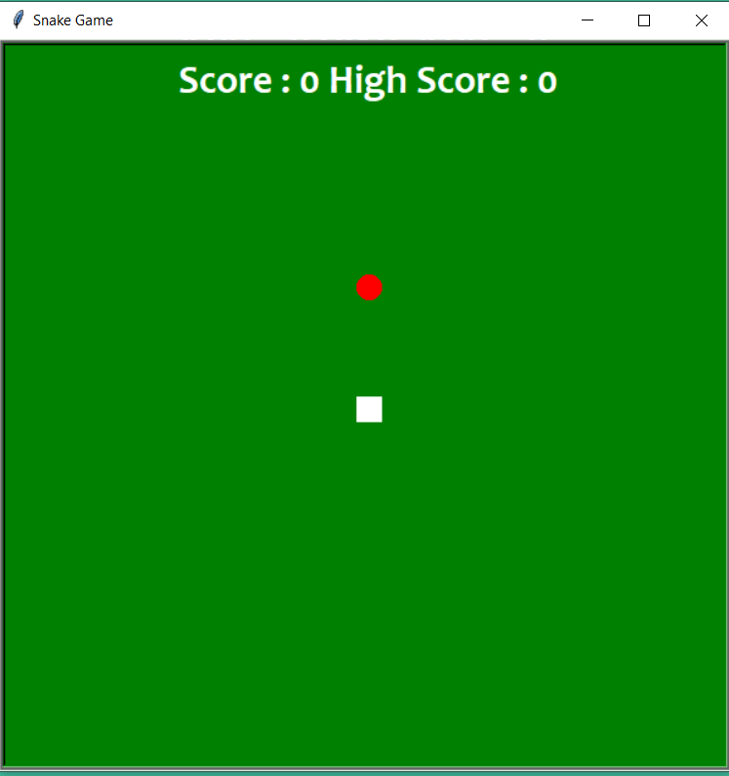
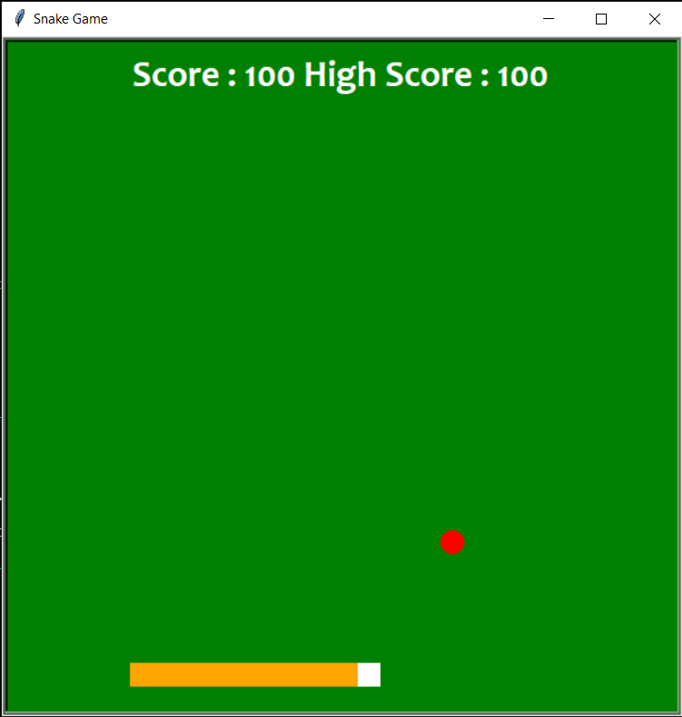
OUTPUT OF SNAKE GAME

Slide 8
2. FLAPPY BIRD GAME
Flappy Bird is a mobile game developed by Vietnamese video game artist and programmer Dong Nguyen, under his game development company .Gears. The game is a side-scroller where the player controls a bird, attempting to fly between columns of green pipes without hitting them.
The term/genre is known as an Endless Runner or Endless Flyer. Endless games are defined by just that... They keep going indefinitely until you inevitably lose, either by ramping up difficulty the longer you go like Jetpack Joyride or just being difficult from the start like Flappy Bird and Swing Copters.
Flappy Bird High Score in History over One Million Points 9,999,999 (World Record) No cheats.

Slide 9
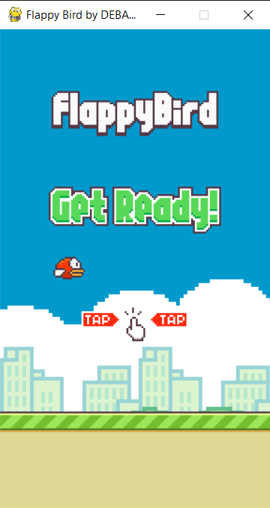
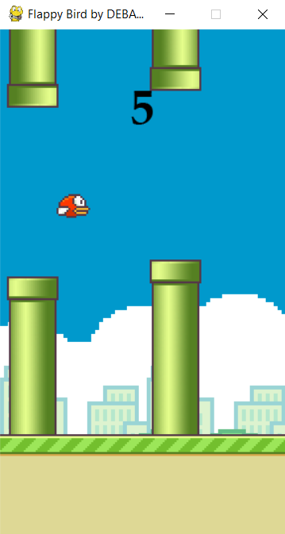
OUTPUT OF FLAPPY BIRD GAME

Slide 10
3. PAC-MAN
Pac-Man is an action maze chase video game; the player controls the eponymous character through an enclosed maze. The objective of the game is to eat all of the dots placed in the maze while avoiding four colored ghosts — Blinky (red), Pinky (pink), Inky (cyan), and Clyde (orange) — that pursue him. When Pac-Man eats all of the dots, the player advances to the next level. If Pac-Man makes contact with a ghost, he will lose a life; the game ends when all lives are lost. Each of the four ghosts have their own unique, distinct artificial intelligence (A.I.), or "personalities"; Blinky gives direct chase to Pac-Man, Pinky and Inky try to position themselves in front of Pac-Man, usually by cornering him, and Clyde will switch between chasing Pac-Man and fleeing from him.
Placed at the four corners of the maze are large flashing "energizers", or "power pellets". Eating these will cause the ghosts to turn blue with a dizzied expression and reverse direction. Pac-Man can eat blue ghosts for bonus points; when eaten, their eyes make their way back to the center box in the maze, where the ghosts "regenerate" and resume their normal activity. Eating multiple blue ghosts in succession increases their point value. After a certain amount of time, blue-colored ghosts will flash white before turning back into their normal, lethal form. Eating a certain number of dots in a level will cause a bonus item - usually in the form of a fruit – to appear underneath the center box, which can be eaten for bonus points.
The game increases in difficulty as the player progresses; the ghosts become faster and the energizers' effect decreases in duration to the point where the ghosts will no longer turn blue and edible. To the sides of the maze are two "warp tunnels", which allow Pac-Man and the ghosts to travel to the opposite side of the screen. Ghosts become slower when entering and exiting these tunnels. Levels are indicated by the fruit icon at the bottom of the screen. In-between levels are short cut scenes featuring Pac-Man and Blinky in humorous, comical situations. The game becomes unplayable at the 256th level due to an integer overflow that affects the game's memory.

Slide 11
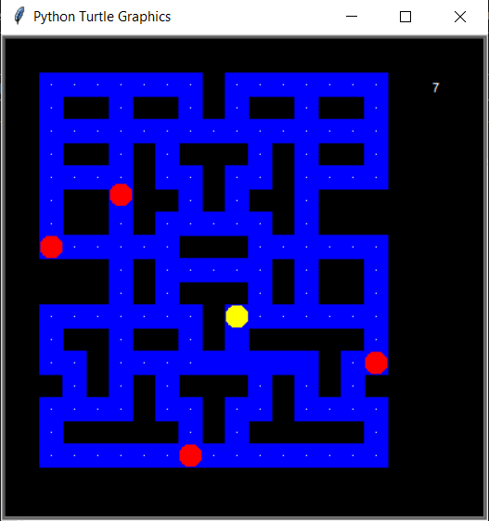
OUTPUT OF PAC-MAN GAME

Slide 12
4. SLIDING PUZZLE
A sliding puzzle, sliding block puzzle, or sliding tile puzzle is a combination puzzle that challenges a player to slide (frequently flat) pieces along certain routes (usually on a board) to establish a certain end-configuration. The pieces to be moved may consist of simple shapes, or they may be imprinted with colors, patterns, sections of a larger picture (like a jigsaw puzzle), numbers, or letters.
Sliding puzzles are essentially two-dimensional in nature, even if the sliding is facilitated by mechanically interlinked pieces (like partially encaged marbles) or three-dimensional tokens. In manufactured wood and plastic products, the linking and encaging is often achieved in combination, through mortise-and-tenon key channels along the edges of the pieces. In at least one vintage case of the popular Chinese cognate game Huarong Road, a wire screen prevents lifting of the pieces, which remain loose. As the illustration shows, some sliding puzzles are mechanical puzzles. However, the mechanical fixtures are usually not essential to these puzzles; the parts could as well be tokens on a flat board that are moved according to certain rules.

Slide 13
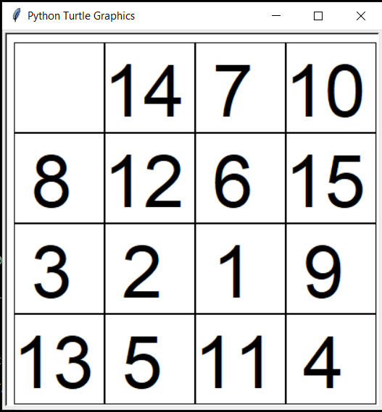
OUTPUT OF SLIDING PUZZLE GAME

Slide 14
5. TIC-TAC-TOE
Games played on three-in-a-row boards can be traced back to ancient Egypt, where such game boards have been found on roofing tiles dating from around 1300 BC.
An early variation of tic-tac-toe was played in the Roman Empire, around the first century BC. It was called Terni lapilli (three pebbles at a time) and instead of having any number of pieces, each player had only three; thus, they had to move them around to empty spaces to keep playing. The game's grid markings have been found chalked all over Rome. Another closely related ancient game is three men's morris which is also played on a simple grid and requires three pieces in a row to finish, and Picaria, a game of the Puebloans.
The different names of the game are more recent. The first print reference to "noughts and crosses" (nought being an alternative word for 'zero'), the British name, appeared in 1858, in an issue of Notes and Queries. The first print reference to a game called "tick-tack-toe" occurred in 1884, but referred to "a children's game played on a slate, consisting of trying with the eyes shut to bring the pencil down on one of the numbers of a set, the number hit being scored".[This quote needs a citation] "Tic-tac-toe" may also derive from "tick-tack", the name of an old version of backgammon first described in 1558. The US renaming of "noughts and crosses" to "tic-tac-toe" occurred in the 20th century.
In 1975, tic-tac-toe was also used by MIT students to demonstrate the computational power of Tinker toy elements. The Tinker toy computer, made out of (almost) only Tinker toys, is able to play tic-tac-toe perfectly. It is currently on display at the Museum of Science, Boston.

Slide 15
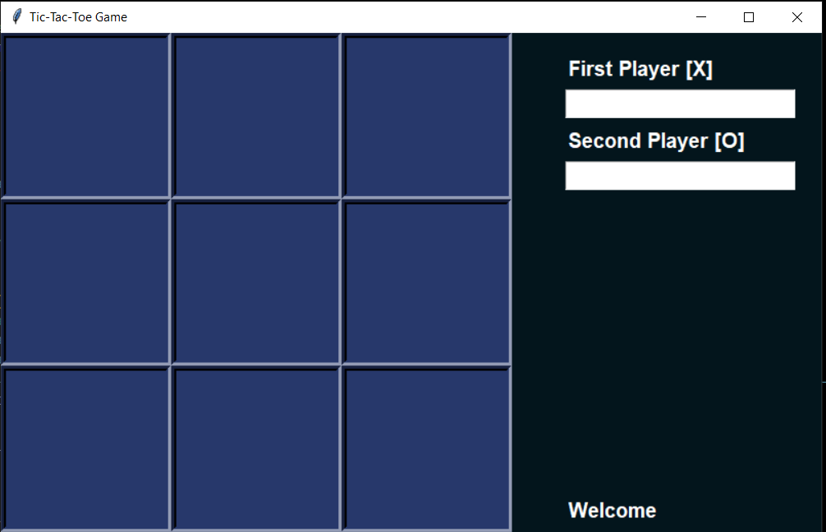
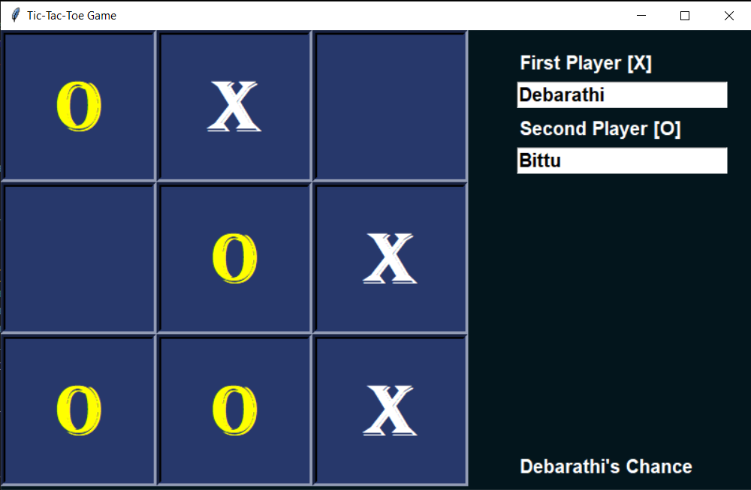
OUTPUT OF TIC-TAC-TOE GAME

Slide 16
6. PONG GAME
Pong is a table tennis–themed twitch arcade sports video game, featuring simple two-dimensional graphics, manufactured by Atari and originally released in 1972. It was one of the earliest arcade video games; it was created by Allan Alcorn as a training exercise assigned to him by Atari co-founder Nolan Bushnell, but Bushnell and Atari co-founder Ted Dabney were surprised by the quality of Alcorn's work and decided to manufacture the game. Bushnell based the game's concept on an electronic ping-pong game included in the Magnavox Odyssey, the first home video game console. In response, Magnavox later sued Atari for patent infringement.
Pong was the first commercially successful video game, and it helped to establish the video game industry along with the Magnavox Odyssey. Soon after its release, several companies began producing games that closely mimicked its gameplay. Eventually, Atari's competitors released new types of video games that deviated from Pong's original format to varying degrees, and this, in turn, led Atari to encourage its staff to move beyond Pong and produce more innovative games themselves.
Atari released several sequels to Pong that built upon the original's gameplay by adding new features. During the 1975 Christmas season, Atari released a home version of Pong exclusively through Sears’s retail stores. The home version was also a commercial success and led to numerous clones. The game was remade on numerous home and portable platforms following its release. Pong is part of the permanent collection of the Smithsonian Institution in Washington, D.C., due to its cultural impact.

Slide 17
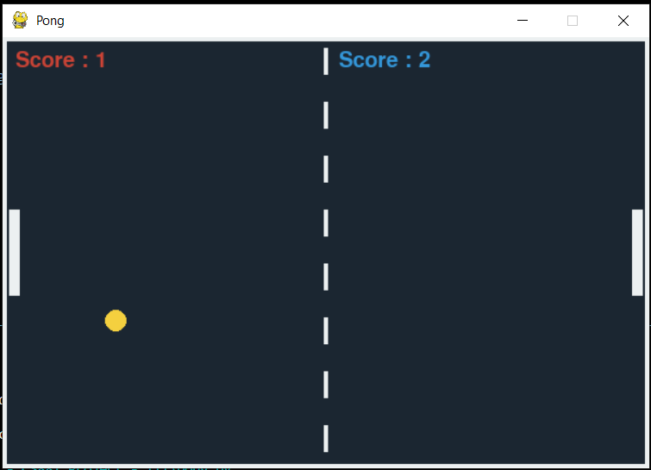
OUTPUT OF PONG GAME

Slide 18
7. ROCK PAPER SCISSOR
Rock Paper Scissors is a hand game originating from China, usually played between two people, in which each player simultaneously forms one of three shapes with an outstretched hand. These shapes are "rock" (a closed fist), "paper" (a flat hand), and "scissors" (a fist with the index finger and middle finger extended, forming a V). "Scissors" is identical to the two-fingered V sign (also indicating "victory" or "peace") except that it is pointed horizontally instead of being held upright in the air.
A simultaneous, zero-sum game, it has three possible outcomes: a draw, a win or a loss. A player who decides to play rock will beat another player who has chosen scissors ("rock crushes scissors" or "breaks scissors" or sometimes "blunts scissors"), but will lose to one who has played paper ("paper covers rock"); a play of paper will lose to a play of scissors ("scissors cuts paper"). If both players choose the same shape, the game is tied and is usually immediately replayed to break the tie. The type of game originated in China and spread with increased contact with East Asia, while developing different variants in signs over time.
Rock Paper Scissors is often used as a fair choosing method between two people, similar to coin flipping, drawing straws, or throwing dice in order to settle a dispute or make an unbiased group decision. Unlike truly random selection methods, however, rock paper scissors can be played with a degree of skill by recognizing and exploiting non-random behavior in opponents.

Slide 19
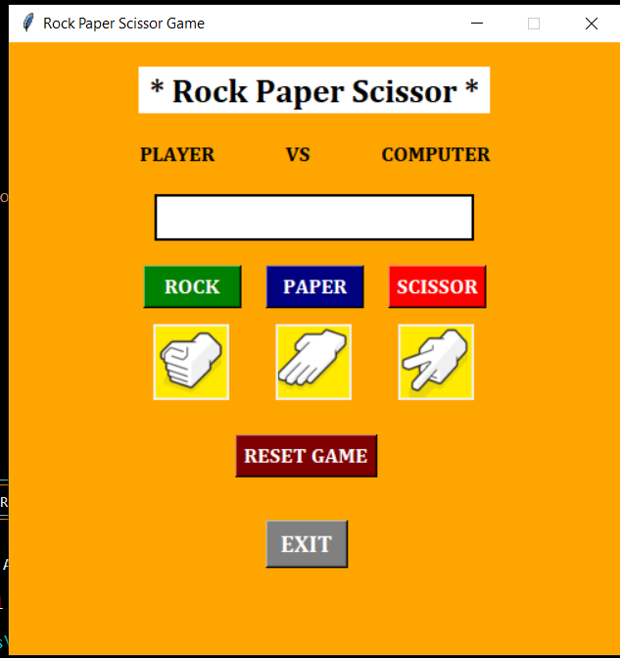
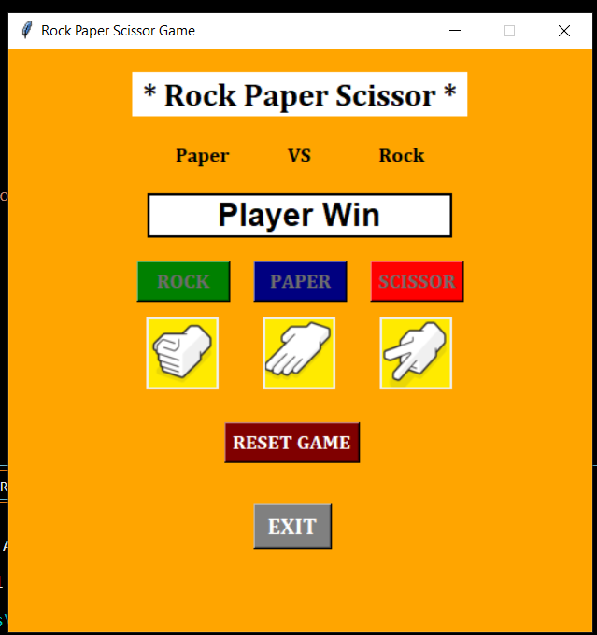
OUTPUT OF ROCK PAPER SCISSOR GAME

Slide 20
8. BUBBLE SORT VISUAL
Bubble Sort is the simplest sorting algorithm that works by repeatedly swapping the adjacent elements if they are in the wrong order.
Example:
First Pass:
(5 1 4 2 8) –> (1 5 4 2 8), Here, algorithm compares the first two elements, and swaps since 5 > 1.
(1 5 4 2 8) –> (1 4 5 2 8), Swap since 5 > 4
(1 4 5 2 8) –> (1 4 2 5 8), Swap since 5 > 2
(1 4 2 5 8) –> (1 4 2 5 8), Now, since these elements are already in order (8 > 5), algorithm does not swap them.
Second Pass:
(1 4 2 5 8) –> (1 4 2 5 8)
(1 4 2 5 8) –> (1 2 4 5 8), Swap since 4 > 2
(1 2 4 5 8) –> (1 2 4 5 8)
1 2 4 5 8) –> (1 2 4 5 8)
Now, the array is already sorted, but our algorithm does not know if it is completed. The algorithm needs one whole pass without any swap to know it is sorted.
Third Pass:
(1 2 4 5 8) –> (1 2 4 5 8)
(1 2 4 5 8) –> (1 2 4 5 8)
(1 2 4 5 8) –> (1 2 4 5 8)
(1 2 4 5 8) –> (1 2 4 5 8)
Bubble sort, sometimes referred to as sinking sort, is a simple sorting algorithm that repeatedly steps through the list, compares adjacent elements and swaps them if they are in the wrong order. The pass through the list is repeated until the list is sorted.

Slide 21
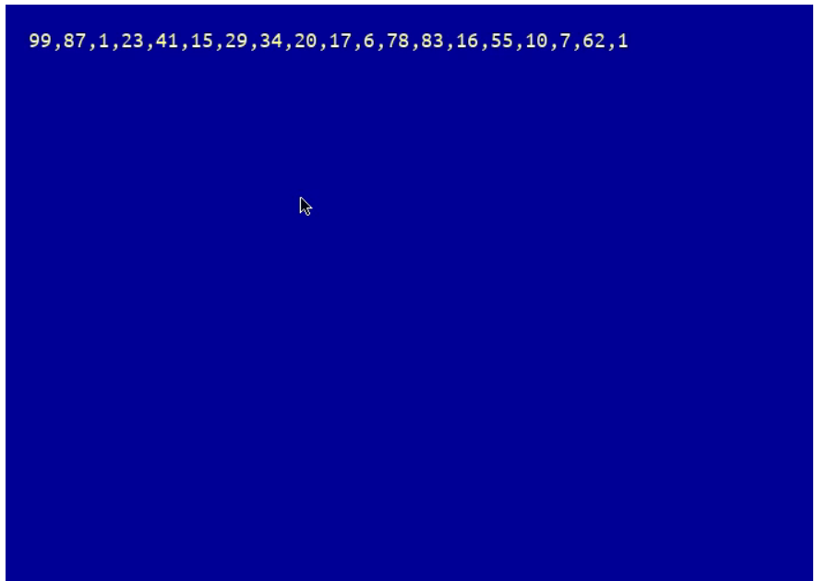
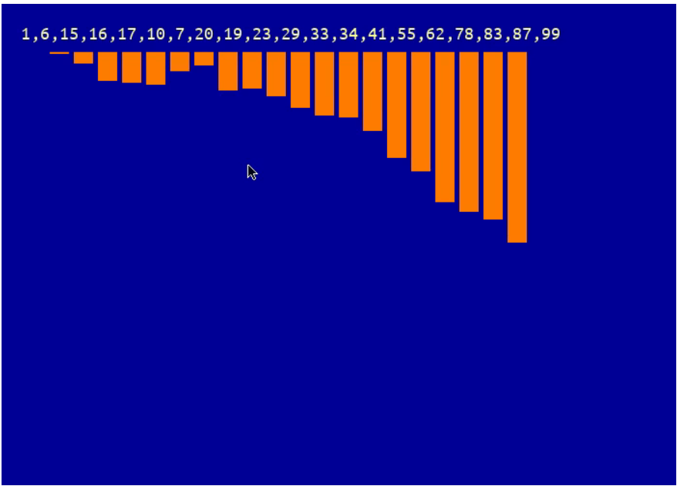
OUTPUT OF BUBBLE SORT VISUAL

Slide 22

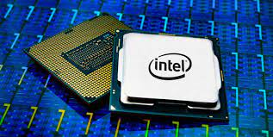

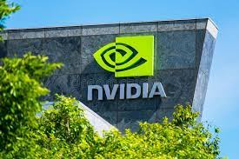
Project Proposal:
PAGE NO: 22
HARDWARE DEVICES
We will be using a laptop to build our project the specification of that device is given below –
Microprocessor:
Intel® Core™ i3-5005U (2 GHz base frequency, 6 MB cache, 4 cores).
Intel® Core™ i5-10300H (4.5 GHz base frequency, 6 MB cache, 4 cores).
Memory, standard:
8 GB DDR3-1600 SDRAM (2 x 4 GB).
Graphics:
AMD Radeon R5 M430 (2000 MB DDR3 dedicated).
NVIDIA GTX 1650TI with 4GB of dedicated GDDR6 VRAM.
Storage:
1. Hard Drive
1 TB 7200 rpm SATA.
2. SSD
M.2 PCle 256GB SSD

Slide 23
SOFTWARE
Visual Studio Code, also commonly referred to as VS Code, is a source-code editor made by Microsoft for Windows, Linux and macOS. Features include support for debugging, syntax highlighting, intelligent code completion, snippets, code refactoring, and embedded Git.
Sublime Text is a shareware cross-platform source code editor. It natively supports many programming languages and markup languages. Users can expand its functionality with plug-in, typically community-built and maintained under free-software licenses.
Python 3.10.0 is the newest major release of the Python programming language, and it contains many new features and optimizations.

Slide 24
MODULE
TKINTER
Tkinter is a standard GUI (graphical user interface) package. Python when combined with Tkinter provides a fast and easy way to create GUI applications.
PYGAME
Pygame is a cross-platform set of Python modules designed for writing video games. It includes computer graphics and sound libraries designed to be used with the Python.
FREE GAMES
Free Python Games is an Apache2 licensed collection of free Python games intended for education and fun.

Slide 25
HOME PAGE CODE
from tkinter import *
import tkinter
def nextpage():
root.destroy()
import Menu_Page
root = Tk()
canvas = Canvas(width=1550, height=860, bg="black")
canvas.pack()
photo = PhotoImage(file="C:\\Users\\Acer\\Desktop\\PROJ - CS881 Project - III\\HomePage.png")
canvas.create_image(0,0, image=photo, anchor=NW)
btn = Button(root, text=" START NOW ",font="Cambria 14 bold",fg="white",bg="maroon",command=nextpage)
btn.pack(padx=25, pady=25)
btn.place(x=419,y=530)

Slide 26
btn = Button(root, text="CLOSE THE WINDOW",font="Cambria 14 bold",fg="white",bg="maroon",command=lambda: root.destroy())
btn.pack(padx=25, pady=25)
btn.place(x=387,y=630)
root.title("Home | Python Game Zone | Welcome")
#root.geometry("1280x720")
root.attributes('-fullscreen' , True)
#root.resizable(False,False)
root.configure(bg="light yellow")
mainloop()

Slide 27
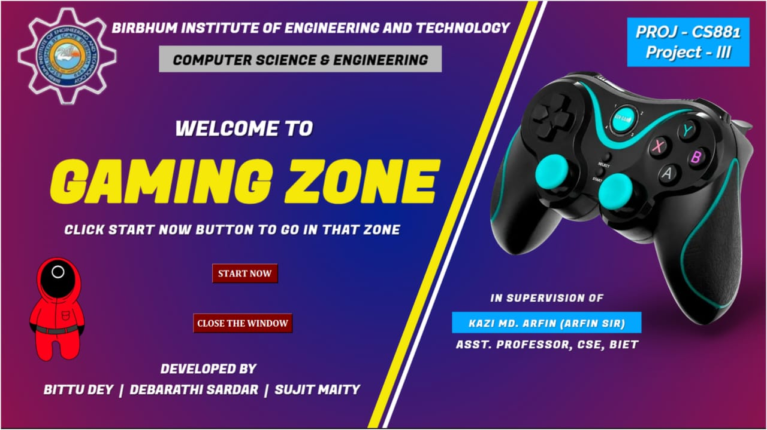
FINAL OVERVIEW:
PAGE NO: 27
HOME PAGE

Slide 28
PAGE NO: 28
MENU PAGE CODE
from tkinter import *
import tkinter
window = tkinter.Tk()
def snake():
#window.destroy()
import snake
def flappybird():
#window.destroy()
import flappybird
def PacMan():
#window.destroy()
import PacMan
def RockPaperScissor():
#window.destroy()
import RockPaperScissor

Slide 29
PAGE NO: 29
def TicTacToe():
#window.destroy()
import TicTacToe
def BubbleSortVisual():
#window.destroy()
import BubbleSortVisual
def pong():
#window.destroy()
import pong
def Tiles():
#window.destroy()
import Tiles
def Game1():
myLabel = Label(window,text="""Snake is a video game genre where the player manoeuvres a growing line that becomes a primary obstacle to itself.""",font="Cambria 12 bold",bg="white",fg="black")
myLabel.pack()
myLabel.place(x=105,y=644)

Slide 30
PAGE NO: 30
def Game2():
myLabel = Label(window,text="""Flappy Bird is a mobile game developed by Vietnamese video game artist and programmer Dong Nguyen. The game is a side-scroller where the player controls a bird, attempting to fly between columns of green pipes without hitting them.""",font="Cambria 12 bold",bg="white",fg="black")
myLabel.pack(padx=20, pady=20)
myLabel.place(x=105,y=644)
def Game3():
myLabel = Label(window,text=""" Pac-Man is a Japanese video game franchise created by Toru Iwatani but published,developed and owned by Bandai Namco Entertainment.""",font="Cambria 12 bold", bg="white", fg="black")
myLabel.pack(padx=20, pady=20)
myLabel.place(x=105,y=644)
def Game4():
myLabel = Label(window,text=""" Tic-tac-toe, noughts and crosses, or Xs and Os is a paper-and-pencil game for two players who take turns marking the spaces in a three-by-three grid with X or O. The player who
succeeds in placing three of their marks in a horizontal, vertical, or diagonal row is the winner. """,font="Cambria 12 bold",bg="white",fg="black")
myLabel.pack(padx=20, pady=20)
myLabel.place(x=105,y=644)

Slide 31
PAGE NO: 31
def Game5():
myLabel = Label(window,text="""Pong is a two-dimensional sports game that simulates table tennis. The player controls an in-game paddle by moving it vertically across the left or right side of the screen.""",font="Cambria 12 bold", bg="white", fg="black")
myLabel.pack(padx=20, pady=20)
myLabel.place(x=105,y=644)
def Game6():
myLabel = Label(window,text="""Rock Paper Scissors is a hand game originating from China, usually played between two people in which each player simultaneously forms one of three shapes. These shapes are "rock", "paper", and "scissors""", font="Cambria 12 bold",bg="white",fg="black")
myLabel.pack(padx=20, pady=20)
myLabel.place(x=105,y=644)
def Game7():
myLabel = Label(window,text="""A sliding puzzle or sliding block puzzle is a combination puzzle that challenges a player to slide pieces along certain routes to establish a certain end-configuration. The pieces to be moved may consist of simple shapes. """,font="Cambria 12 bold", bg="white", fg="black")
myLabel.pack(padx=20, pady=20)
myLabel.place(x=105,y=644)

Slide 32
PAGE NO: 32
def Game8():
myLabel = Label(window,text=""" Bubble sort, sometimes referred to as sinking sort, is a simple sorting algorithm that repeatedly steps through the list, compares adjacent elements and swaps them if they are in the wrong order.The pass through the list is repeated until the list is sorted. """,font="Cambria 12 bold",bg="white",fg="black")
myLabel.pack(padx=20, pady=20)
myLabel.place(x=105,y=644)
window.title("Main Menu")
canvas999= Canvas(width=1550, height=715 , bg ='black' )
canvas999.pack()
#canva9992.place(x=75, y=165)
photo999= PhotoImage(file="C:\\Users\\Acer\\Desktop\\PROJ - CS881 Project - III\\MenuPage.png")
canvas999.create_image(0,0, image=photo999, anchor=NW)
#lbl = Label(window, text=" * * * LIST OF GAMES * * * " , bg="BLUE", fg="White",font= ('Cambria 19 bold'))
#lbl.pack()

Slide 33
PAGE NO: 33
canvas1 = Canvas(width=100, height=100 , bg ='white' )
canvas1.pack()
canvas1.place(x=310, y=170)
photo1 = PhotoImage(file='C:\\Users\\Acer\Desktop\\PROJ - CS881 Project - III\\HungrySnake.png')
canvas1.create_image(0,0, image=photo1, anchor=NW)
LL1 = Label(window, text=" Hungry Snake ",font="Calibri 15 bold",fg="red3",bg="white")
LL1.pack()
LL1.place(x=298,y=142)
btn1 = Button(window, text="P L A Y" , command=snake)
btn1.pack(padx=20, pady=20)
btn1.place(x=265, y=280)
btn1.configure(height=2 , width =8, font = 'Aerial 12 bold italic' , bg = 'blue3' , fg = 'white' )
btn11 = Button(window, text="A B O U T" , command=Game1)
btn11.pack(padx=20, pady=20)
btn11.place(x=365, y=280)
btn11.configure(height=2 , width =8, font = 'Aerial 12 bold italic' , bg = 'green4' , fg = 'white' )

Slide 34
PAGE NO: 34
canvas2 = Canvas(width=100, height=100 , bg ='white' )
canvas2.pack()
canvas2.place(x=577, y=170)
photo2 = PhotoImage(file='C:\\Users\\Acer\\Desktop\\PROJ - CS881 Project - III\\FlappyBird.png')
canvas2.create_image(0,0, image=photo2, anchor=NW)
LL2 = Label(window, text=" Flappy Bird ",font="Calibri 15 bold", fg="red3", bg="white")
LL2.pack()
LL2.place(x=573,y=152)
btn2 = Button(window, text="P L A Y" , command=flappybird )
btn2.pack(padx=20, pady=20)
btn2.place(x=534, y=280)
btn2.configure(height=2,width =8, font = 'Aerial 12 bold italic',bg = 'blue3', fg = 'white')
btn22 = Button(window, text="A B O U T" , command=Game2)
btn22.pack(padx=20, pady=20)
btn22.place(x=634, y=280)
btn22.configure(height=2,width=8,font = 'Aerial 12 bold italic',bg = 'green4',fg = 'white')

Slide 35
PAGE NO: 35
canvas3 = Canvas(width=100, height=100 , bg ='white' )
canvas3.pack()
canvas3.place(x=875, y=170)
photo3 = PhotoImage(file='C:\\Users\\Acer\\Desktop\\PROJ - CS881 Project - III\\PacMan.png')
canvas3.create_image(0,0, image=photo3, anchor=NW)
LL3 = Label(window, text=" Pac - Man ",font="Calibri 15 bold",fg="red3",bg="white")
LL3.pack()
LL3.place(x=876,y=142)
btn3 = Button(window, text="P L A Y" , command=PacMan)
btn3.pack(padx=20, pady=20)
btn3.place(x=830, y=280)
btn3.configure(height=2 , width =8, font = 'Aerial 12 bold italic' , bg = 'BLUE3' , fg = 'white')
btn33 = Button(window, text="A B O U T", command=Game3)
btn33.pack(padx=20, pady=20)
btn33.place(x=930, y=280)
btn33.configure(height=2 , width =8, font = 'Aerial 12 bold italic' , bg = 'green4' , fg = 'white')

Slide 36
PAGE NO: 36
canvas7 = Canvas(width=100, height=100 , bg ='white' )
canvas7.pack()
canvas7.place(x=1135, y=170)
photo7 = PhotoImage(file='C:\\Users\\Acer\\Desktop\\PROJ - CS881 Project - III\\SlidingPuzzle.png')
canvas7.create_image(0,0, image=photo7, anchor=NW)
LL7 = Label(window, text=" Sliding Puzzle ",font="Calibri 15 bold",fg="red3",bg="white")
LL7.pack()
LL7.place(x=1120,y=142)
btn7 = Button(window, text="P L A Y" , command=Tiles )
btn7.pack(padx=20, pady=20)
btn7.place(x=1090, y=280)
btn7.configure(height=2 , width =8, font = 'Aerial 12 bold italic' , bg = 'BLUE3' , fg = 'white')
btn77 = Button(window, text="A B O U T", command=Game7)
btn77.pack(padx=20, pady=20)
btn77.place(x=1190, y=280)
btn77.configure(height=2 , width =8, font = 'Aerial 12 bold italic' , bg = 'green4' , fg = 'white')

Slide 37
PAGE NO: 37
btn99 = Button(window,height=2 , width =12,text="E X I T", font = 'Aerial 12 bold' ,bg = 'aquamarine2',fg = 'black',command=lambda:window.destroy(), border = '10')
btn99.pack()
btn99.place(x=710, y=730)
#clear
def clear():
myLabel = Label(window,text=""" !!! Clear by DS !!! Clear by DS !!! Clear by DS !!! Clear by DS !!! Clear by DS !!! Clear by DS !!! Clear by DS !!! Clear by DS !!!Clear by DS !!! Clear by DS !!! Clear by DS !!! @DEBARATHI SARDAR
!!! Clear by DS !!! Clear by DS !!! Clear by DS !!! Clear by DS !!!Clear by DS !!!Clear by DS !!!Clear by DS !!! .""",font="Cambria 12 bold",bg="#41c5a7",fg="#41c5a7")
myLabel.pack(padx=20, pady=20)
myLabel.place(x=105,y=644)
btn999 = Button(window,height=1 , width =8,text="C L E A R", font = 'Aerial 12 bold' ,bg = 'black',fg = 'gold', command=clear)
btn999.pack()
btn999.place(x=732, y=607)

Slide 38
PAGE NO: 38
canvas4 = Canvas(width=100, height=100 , bg ='white' )
canvas4.pack()
canvas4.place(x=310, y=389)
photo4 = PhotoImage(file='C:\\Users\\Acer\\Desktop\\PROJ - CS881 Project - III\\TicTacToe.png')
canvas4.create_image(0,0, image=photo4, anchor=NW)
LL4 = Label(window, text=" Tic-Tac-Toe ",font="Calibri 15 bold",fg="red3",bg="white")
LL4.pack()
LL4.place(x=305,y=360)
btn4 = Button(window, text="P L A Y" , command=TicTacToe )
btn4.pack(padx=20, pady=20)
btn4.place(x=265, y=503)
btn4.configure(height=2 , width =8, font = 'Aerial 12 bold italic' , bg = 'BLUE3', fg = 'white')
btn44 = Button(window, text="A B O U T", command=Game4)
btn44.pack(padx=20, pady=20)
btn44.place(x=365, y=503)
btn44.configure(height=2 , width =8, font = 'Aerial 12 bold italic' , bg = 'green4' , fg = 'white')

Slide 39
PAGE NO: 39
canvas5 = Canvas(width=100, height=100 , bg ='white' )
canvas5.pack()
canvas5.place(x=577, y=389)
photo5 = PhotoImage(file='C:\\Users\\Acer\\Desktop\\PROJ - CS881 Project - III\\Pong.png')
canvas5.create_image(0,0, image=photo5, anchor=NW)
LL5 = Label(window, text=" Pong ",font="Calibri 15 bold",fg="red3",bg="white")
LL5.pack()
LL5.place(x=595,y=360)
btn5 = Button(window, text="P L A Y", command=pong )
btn5.pack(padx=20, pady=20)
btn5.place(x=536, y=503)
btn5.configure(height=2 , width =8, font = 'Aerial 12 bold italic' , bg = 'BLUE3', fg = 'white')
btn55 = Button(window, text="A B O U T", command=Game5)
btn55.pack(padx=20, pady=20)
btn55.place(x=634, y=503)
btn55.configure(height=2 , width =8, font = 'Aerial 12 bold italic' , bg = 'green4' , fg = 'white')

Slide 40
PAGE NO: 40
canvas6 = Canvas(width=100, height=100 , bg ='white' )
canvas6.pack()
canvas6.place(x=875, y=389)
photo6 = PhotoImage(file='C:\\Users\\Acer\\Desktop\\PROJ - CS881 Project - III\\RockPaperScissors.png')
canvas6.create_image(0,0, image=photo6, anchor=NW)
LL6 = Label(window, text=" Rock Paper Scissors ",font="Calibri 15 bold",fg="red3",bg="white")
LL6.pack()
LL6.place(x=835,y=360)
btn6 = Button(window, text="P L A Y" , command=RockPaperScissor )
btn6.pack(padx=20, pady=20)
btn6.place(x=830, y=503)
btn6.configure(height=2 , width =8, font = 'Aerial 12 bold italic' , bg = 'blue3', fg = 'white')
btn66 = Button(window, text="A B O U T", command=Game6)
btn66.pack(padx=20, pady=20)
btn66.place(x=930, y=503)
btn66.configure(height=2 , width =8, font = 'Aerial 12 bold italic' , bg = 'green4' , fg = 'white')

Slide 41
PAGE NO: 41
canvas8 = Canvas(width=100, height=100 , bg ='white' )
canvas8.pack()
canvas8.place(x=1135, y=389)
photo8 = PhotoImage(file='C:\\Users\\Acer\\Desktop\\PROJ - CS881 Project - III\\BubbleSortVisual.png')
canvas8.create_image(0,0, image=photo8, anchor=NW)
LL8 = Label(window, text=" Bubble Sort Visual ",font="Calibri 15 bold",fg="red3",bg="white")
LL8.pack()
LL8.place(x=1102,y=360)
btn8 = Button(window, text="P L A Y" , command=BubbleSortVisual)
btn8.pack(padx=20, pady=20)
btn8.place(x=1090, y=503)
btn8.configure(height=2 , width =8, font = 'Aerial 12 bold italic' , bg = 'BLUE3' , fg = 'white')
btn88 = Button(window, text="A B O U T", command=Game8)
btn88.pack(padx=20, pady=20)
btn88.place(x=1190, y=503)
btn88.configure(height=2 , width =8, font = 'Aerial 12 bold italic' , bg = 'green4' , fg = 'white')

Slide 42
PAGE NO: 42
#Developed By
lbl = Label(window, text="Developed By",font="Calibri 13 bold italic",bg="light yellow",fg="black")
lbl.pack()
lbl.place(x=731,y=807)
lbl = Label(window, text=" BITTU DEY | DEBARATHI SARDAR | SUJIT MAITY ",font="Calibri 13 bold",bg="light yellow",fg="black")
lbl.pack()
lbl.place(x=604,y=830)
window.configure(bg='light yellow')
#window.resizable(False , False)
window.attributes('-fullscreen' , True)
#window.geometry("635x610")
window.mainloop()

Slide 43
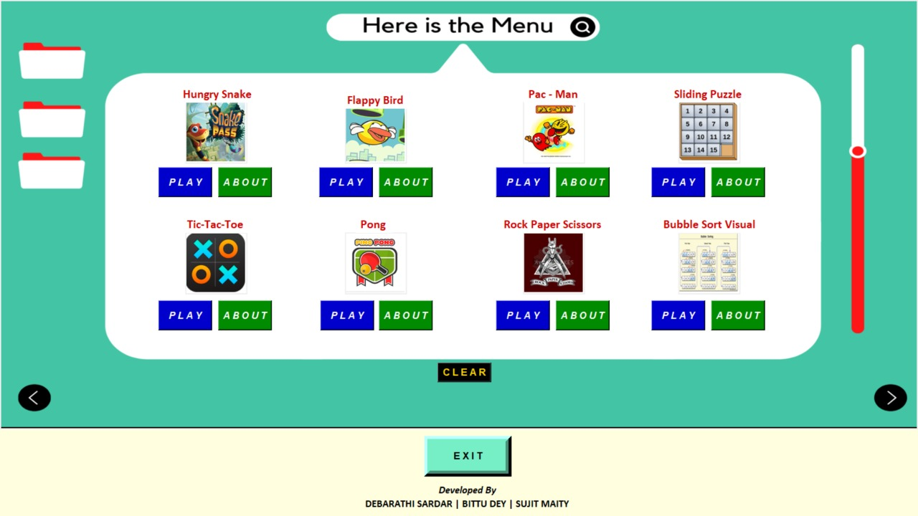
FINAL OVERVIEW:
PAGE NO: 43
MENU PAGE

Slide 44
REFERENCE :
PAGE NO: 44
All about Operations of Python and its Functions and Modules from W3 Schools (www.w3schools.com/python/)
Tkinter – Python interface to Tcl/Tk (Notes, Commands, Modules, Uses) – (https://docs.python.org/3/library/tkinter.html) in python.org
Python based games using Turtle / Free games modules from Geeks for Geeks (https://www.geeksforgeeks.org)
Python Based Game using pygame module (Game Development Library / Pygame Tutorial) from JavatPoint (https://www.javatpoint.com/pygame) and Edureka (https://www.edureka.co/blog/pygame-tutorial)
Python Tkinter Tutorial | GUI programming Using Tkinter from Tutorial Point (https://www.tutorialspoint.com/python/python_gui_programming.htm)
* THE END *
Notes:
THANK YOU

